Slide 1
LINUX DEVICE DRIVER
DAY 42 PPT
-SUBITHRA S

Slide 2
WHY IS DMA?
IT IS WASTEFUL TO FEED DATA INTO A CONTROLLER REGISTER 1 BYTES AT A TIME. (PIO)
THE DMA UNIT IS WORD.
IN THE HIGH LOADING ENVIRONMENT, A SYSTEM WITH DMA HAS BETTER IMPROVEMENT.

Slide 3
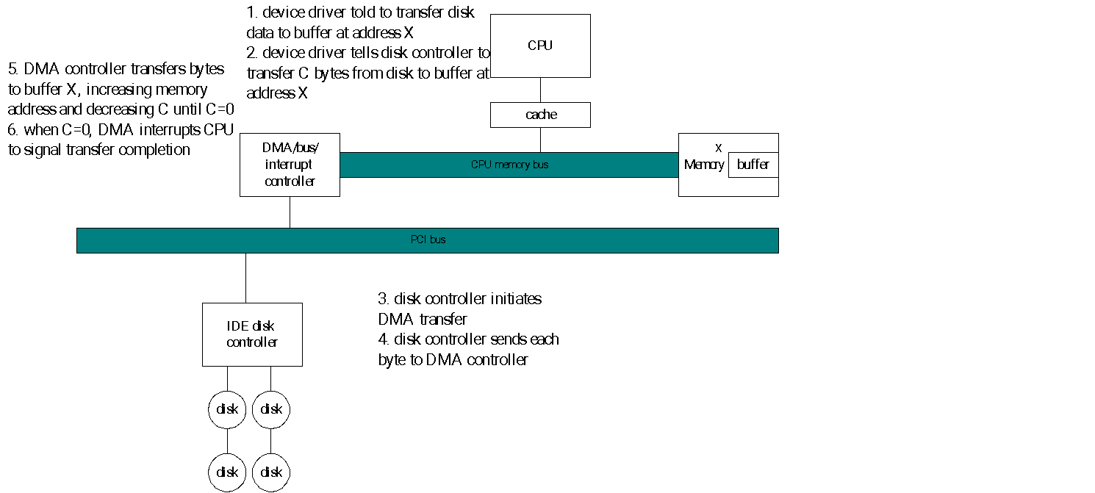
DMA TRANSFER

Slide 4
DMA PROGRESS
TO INITIATE A DMA TRANSFER, THE HOST WRITES A DMA COMMAND INTO MEMORY:
A POINTER TO THE SOURCE OF A TRANSFER
A COUNT OF THE NUMBER OF BYTES TO BE TRANSFERRED
……..
THE CPU WRITES THE ADDRESS OF THE DMA COMMAND BLOCK TO THE DMA CONTROLLER.

Slide 5
DMA PROGRESS (CONT.)
THE DMA CONTROLLER PROCEEDS TO OPERATE THE MEMORY BUS DIRECTLY WITHOUT CPU HELP.
HANDSHAKING EXISTS BETWEEN DMA CONTROLLER AND DEVICE CONTROLLER.
WHEN THE ENTIRE TRANSFER IS FINISHED, THE DMA CONTROLLER WILL INTERRUPTS THE CPU.

Slide 6
HANDSHAKING
DMA-REQUEST AND DMA_ACKNOWLEDGE
WHEN A WORD OF DATA IS AVAILABLE, THE DEVICE CONTROLLER PLACES A SIGNAL ON THE DMA-REQUEST WIRE.
THE SIGNAL CAUSES THE DMA CONTROLLER TO SEIZE THE MEMORY BUS,
TO PLACE THE DESIRED ADDRESS ON THE MEMORY-ADDRESS WIRE
TO PLACE A SIGNAL ON THE DMA-ACKNOWLEDGE WIRE

Slide 7
HANDSHAKING (CONT.)
WHEN THE DEVICE CONTROLLER RECEIVES THE DMA-ACKNOWLEDGE SIGNAL,
IT TRANSFER THE WORD OF DATA TO MEMORY
AND REMOVE THE DMA_REQUEST SIGNAL.

Slide 8
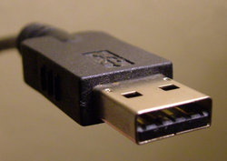
UNIVERSAL SERIAL BUS
A REPRESENTATIVE PERIPHERAL INTERFACE
UNIVERSAL SERIAL BUS (USB) PROVIDES A SERIAL BUS STANDARD FOR CONNECTING DEVICES, USUALLY TO A COMPUTER, BUT IT ALSO IS IN USE ON OTHER DEVICES SUCH AS SET-TOP BOXES, GAME CONSOLES AND PDAS. (WIKIPEDIA.ORG)

Slide 9
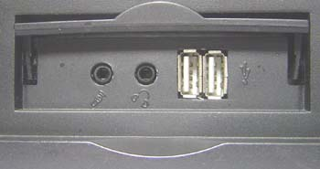
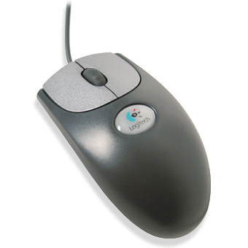
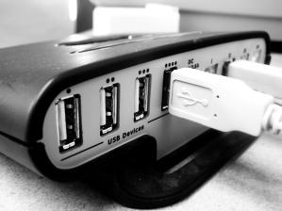
WHAT USB CAN DO
USB IS A LIKELY SOLUTION ANY TIME YOU WANT TO USE A COMPUTER TO COMMUNICATE WITH DEVICES OUTSIDE THE COMPUTER.
THE INTERFACE IS SUITABLE FOR ONE-OF-KIND AND SMALL-SCALE DESIGNS AS WELL AS MASS-PRODUCED, STANDARD PERIPHERAL TYPES.

Slide 10
USB
FAST
BI-DIRECTIONAL
ISOCHRONOUS
LOW-COST
DYNAMICALLY ATTACHABLE SERIAL INTERFACE
CONSISTENT WITH THE REQUIREMENTS OF THE PC PLATFORM OF TODAY AND TOMORROW

Slide 11
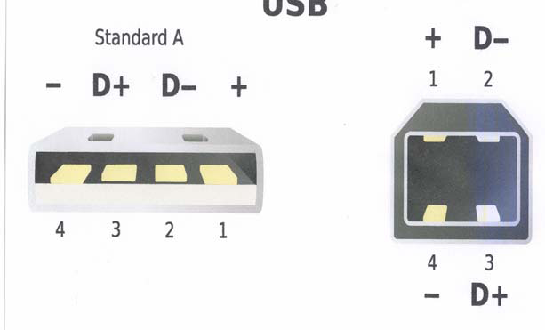
USB
FOUR WIRES (+5V, RETURN, DATA TWISTED PAIR)
UP TO 5 M (16.4 FT)
LONGER CONNECTIONS USE HUBS OR ACTIVE
EXTENSIONS

Slide 12
FEATURES OF USB
EASY TO USE FOR END USER
SINGLE MODEL FOR CABLING AND CONNECTORS
ELECTRICAL DETAILS ISOLATED FROM END USER (E.G., BUS TERMINATIONS)
SELF-IDENTIFYING PERIPHERALS, AUTOMATIC MAPPING OF FUNCTION TO DRIVER, AND CONFIGURATION
DYNAMICALLY ATTACHABLE AND RE-CONFIGURABLE PERIPHERALS
WIDE RANGE OF WORKLOADS AND APPLICATIONS
SUITABLE FOR DEVICE BANDWIDTHS RANGING FROM A FEW KB/S TO SEVERAL MB/S
SUPPORTS ISOCHRONOUS AS WELL AS ASYNCHRONOUS TRANSFER TYPES OVER THE SAME SET OF WIRES
SUPPORTS CONCURRENT OPERATION OF MANY DEVICES (MULTIPLE CONNECTIONS)
SUPPORTS TRANSFER OF MULTIPLE DATA AND MESSAGE STREAMS BETWEEN THE HOST AND DEVICES
LOW-COST IMPLEMENTATION
LOW-COST SUB-CHANNEL AT 1.5MB/S
SUITABLE FOR DEVELOPMENT OF LOW-COST PERIPHERALS
LOW-COST CABLES AND CONNECTORS
UPGRADE PATH
ARCHITECTURE UPGRADEABLE TO SUPPORT MULTIPLE USB HOST CONTROLLERS IN A SYSTEM

Slide 13
FEATURES OF USB (CNT..)
ISOCHRONOUS BANDWIDTH
GUARANTEED BANDWIDTH AND LOW LATENCIES APPROPRIATE FOR TELEPHONY, AUDIO, ETC.
ISOCHRONOUS WORKLOAD MAY USE ENTIRE BUS BANDWIDTH
FLEXIBILITY
SUPPORTS A WIDE RANGE OF PACKET SIZES, WHICH ALLOWS A RANGE OF DEVICE BUFFERING OPTIONS
ALLOWS A WIDE RANGE OF DEVICE DATA RATES BY ACCOMMODATING PACKET BUFFER SIZE AND LATENCIES
FLOW CONTROL FOR BUFFER HANDLING IS BUILT INTO THE PROTOCOL
ROBUSTNESS
ERROR HANDLING/FAULT RECOVERY MECHANISM IS BUILT INTO THE PROTOCOL
DYNAMIC INSERTION AND REMOVAL OF DEVICES IS IDENTIFIED IN USER-PERCEIVED REAL-TIME
SUPPORTS IDENTIFICATION OF FAULTY DEVICES

Slide 14
COMPARISON
Interface | Format | Number of Devices (maximum) | Length (maximum, feet) | Speed (maximum, bits/sec.) | Typical Use
USB | asynchronous serial | 127 | 16 (or up to 96 ft. with 5 hubs) | 1.5M, 12M, 480M | Mouse, keyboard, disk drive, modem, audio
RS-232 (EIA/TIA-232) | asynchronous serial | 2 | 50-100 | 20k (115k with some hardware) | Modem, mouse, instrumentation
Parallel Printer Port | parallel | 2 (8 with daisy-chain support) | 10–30 | 8M | Printers, scanners, disk drives

Slide 15
BENEFITS FOR USERS
EASE OF USE EASE OF USE WAS A MAJOR DESIGN GOAL FOR USB, AND THE RESULT IS AN INTERFACE THAT’S A PLEASURE TO USE FOR MANY REASONS:
ONE INTERFACE FOR MANY DEVICES. USB IS VERSATILE ENOUGH TO BE USABLE WITH MANY KINDS OF PERIPHERALS. INSTEAD OF HAVING A DIFFERENT CONNECTOR TYPE AND SUPPORTING HARDWARE FOR EACH PERIPHERAL, ONE INTERFACE SERVES MANY.
AUTOMATIC CONFIGURATION. WHEN A USER CONNECTS A USB PERIPHERAL TO A COMPUTER, ITS OS AUTOMATICALLY DETECTS THE PERIPHERAL AND LOADS THE APPROPRIATE SOFTWARE DRIVER.
HOT PLUGGABLE WE CAN CONNECT AND DISCONNECT A PERIPHERAL WHENEVER YOU WANT, WHETHER OR NOT THE SYSTEM AND PERIPHERAL ARE POWERED, WITHOUT DAMAGING THE PC OR PERIPHERAL. THE OPERATING SYSTEM DETECTS WHEN A DEVICE IS ATTACHED AND READIES IT FOR USE.
NO POWER SUPPLY REQUIRED (SOMETIMES). A PERIPHERAL THAT REQUIRES UP TO 500 MILLIAMPERES CAN DRAW ALL OF ITS POWER FROM THE BUS INSTEAD OF HAVING ITS OWN SUPPLY..

Slide 16
USB
USB 1.0 specification introduced in 1994
USB 2.0 specification finalized in 2001
Became popular due to cost/benefit advantage
Eg. IEEE 1394 – high bandwidth, high cost
Three generations of USB
USB 1.0
USB 2.0
USB 3.0 and WUSB
Notes:
IEEE 1394 – high bandwidth, high cost – This refers to accommodating low cost/ low performance peripherals (mouse, keyboard)

Slide 17
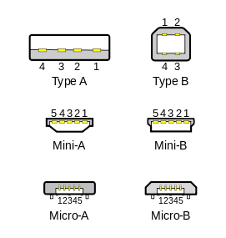
PHYSICAL APPEARANCES
TYPE A CONNECTORS ON HOST DEVICES THAT SUPPLY POWER
TYPE B CONNECTORS ON TARGET DEVICES THAT RECEIVE POWER.

Slide 18
THANK YOU

